Slide 1
Rethinking the model of international MEL: What must we do differently to overcome MEL challenges in a post-COVID world?
Patricia Rogers, BetterEvaluation
Australian Council for International Development Monitoring, Evaluation and Learning Community of Practice (ACFID MELCOP)webinar
Melbourne 29 July 2020

Slide 2
Seriously address complexity

Slide 3
Evaluation for completely simple interventions
What interventions look like | Discrete, standardized intervention
How interventions work | Pretty much the same everywhere
Common evaluation questions | What works? Are we doing it the right way?
Nature of recommendations | Single way to do it Best practices
Process needed for evaluation uptake | Knowledge transfer
Metaphor for evaluation findings | Google directions (one way to do it – little skill needed to follow instructions)

Slide 4
Evaluation for interventions with complicated aspects
What interventions look like | Different in different situations
How interventions work | Differently in different situations (different people or different implementation environments)
Common evaluation questions | What works for whom in what contexts?
Nature of recommendations | Contingent Good practices in particular situations
Process needed for evaluation uptake | Knowledge translation to new situations
Metaphor for evaluation findings | Transport map and timetable (need some skill to choose the most appropriate option for that time and place)

Slide 5
Impact evaluation for interventions with complex aspects
What interventions look like | Non standardized and changing, adaptive, and emergent
How interventions work | Results sensitive to initial conditions as well as to context, generalisations rapidly decay
Common evaluation questions | What is working? How do we understand this?
Nature of recommendation | Dynamic and emergent Principles
Process needed for evaluation uptake | Ongoing knowledge generation
Metaphor for evaluation findings | Topographical map and compass (need to work it out as you go along)

Slide 6
Implications of addressing complexity in MEL – operating in conditions of ongoing uncertainty and lack of predictability
MANAGE | Partnering and supporting local control and conduct of evaluation More rapid turnaround evaluations Emergent M & E plans
DEFINE | Theories of change with explicit change theories and action theories that guide evaluation and are adapted, address emergent change
FRAME | Questions that focus on informing adaptive action
DESCRIBE | Data that can be collected despite pandemic restrictions and dangers
UNDERSTAND CAUSES | Non-experimental causal inference that does not assume stable situations and can use diverse data
SYNTHESISE | Rapid, realist synthesis that draws on theories of change and diverse evidence
REPORT AND SUPPORT USE | Timely, targeted knowledge products Engagement to translate findings to new contexts
Logo here
₆

Slide 7
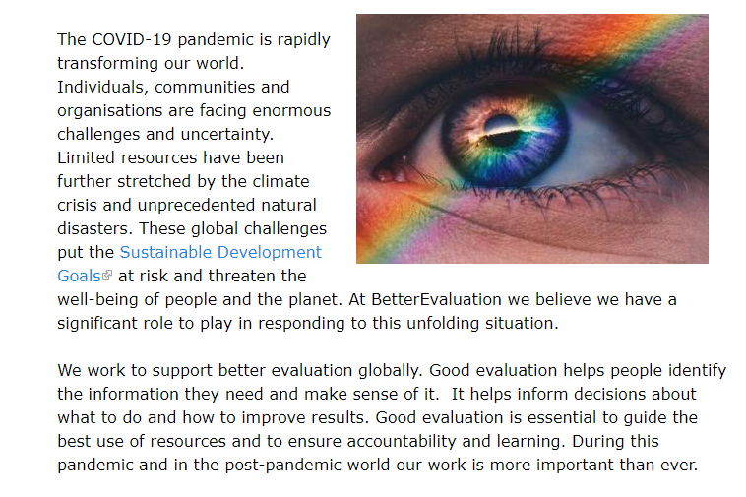
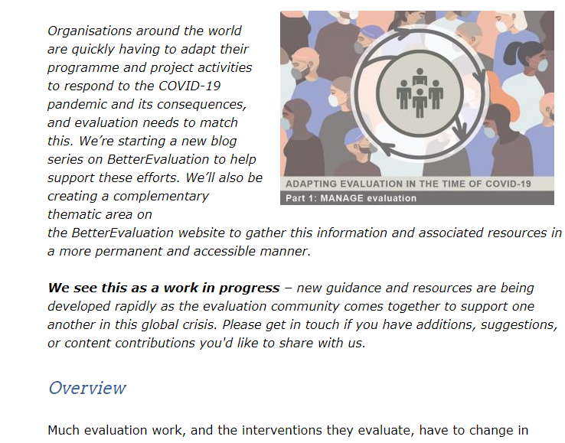
COVID-19 statement
Sharing resources on adapting evaluation in a time of COVID-19
https://www.betterevaluation.org/en/blog/betterevaluation-covid-19-statement
Adapting evaluation in a time of COVID-19 – blog series and thematic page
https://www.betterevaluation.org/en/blog/adapting-evaluation-time-covid-19-part-1-manage
https://www.betterevaluation.org/en/blog/adapting-evaluation-time-covid-19-%E2%80%94-part-2-define
@BetterEval Twitter
Logo here
₇

